Slide 1
CSE326 Internet Programming Laboratory Lecture #6
Dr. Navneet Kaur

Slide 2
Outline
CSS Box model
Parts of a CSS Box model
Margin
Padding
Border
Physical and logical style elements in HTML
CSS text formatting

Slide 3
CSS Box model
The CSS box model as a whole applies to block boxes and defines how the different parts of a box — margin, border, padding, and content — work together to create a box that you can see on a page.

Slide 4
Parts of a CSS box model
Margin box: The margin is the outermost layer, wrapping the content, padding, and border as whitespace between this box and other elements; size it using margin and related properties.
Border box: The border box wraps the content and any padding; size it using border and related properties.
Padding box: The padding sits around the content as white space; size it using padding and related properties.
Content box: The area where your content is displayed.

Slide 5
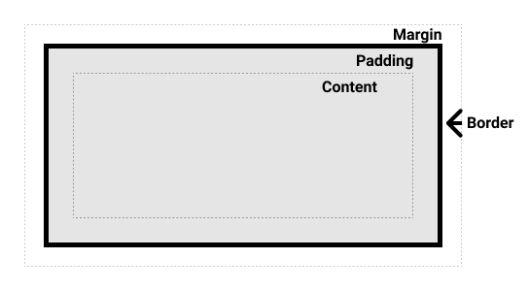
Parts of a CSS box model

Slide 6
Margin
The margin is an invisible space around your box.
It pushes other elements away from the box.
Margins can have positive or negative values.
Setting a negative margin on one side of your box can cause it to overlap other things on the page.
margin-top
margin-right
margin-bottom
margin-left

Slide 7
Borders
The border is drawn between the margin and the padding of a box.
border-width
border-style
border-color
border-top
border-right
border-bottom
border-left

Slide 8
Borders
border-top-width
border-top-style
border-top-color
border-right-width
border-right-style
border-right-color
border-bottom-width
border-bottom-style
border-bottom-color
border-left-width
border-left-style
border-left-color

Slide 9
Padding
The padding sits between the border and the content area and is used to push the content away from the border.
Unlike margins, you cannot have a negative padding.
Any background applied to your element will display behind the padding.
padding-top
padding-right
padding-bottom
padding-left

Slide 10
Physical and logical style elements in HTML
Physical style elements:
These are the elements that are primarily used for defining the appearance and presentation of content.
They are traditionally used for styling and layout purposes.
These elements are often associated with visual formatting and are considered somewhat outdated in modern web development, as the recommended practice is to use CSS for styling.

Slide 11
Physical and logical style elements in HTML
Examples of physical style elements:
<b>: Represents bold text. It is used to make text visually bold.
<i>: Represents italicized text. It is used to make text appear in italics.
<u>: Represents underlined text. It is used to underline text.
<strike>: Represents strikethrough text. It is used to put a line through the text.
<font>: Used for specifying font attributes like size, color, and face.

Slide 12
Physical and logical style elements in HTML
Logical style elements:
Logical style elements, also known as semantic elements, are HTML elements that convey the meaning and structure of content rather than its presentation.
These elements are designed to describe the purpose or function of the content they enclose, making it easier for both humans and search engines to understand the document's structure and content.

Slide 13
Physical and logical style elements in HTML
Examples of logical style elements:
<abbr>: Defines an abbreviation
<acronym>: Defines an acronym
<address>: Defines an address element
<cite>: Defines citation
<code>: Defines computer code text
<blockquote>: Defines a long quotation
<del>: Defines deleted text
<dfn>: Defines a definition term
<ins>: Defines inserted text

Slide 14
Physical and logical style elements in HTML
Examples of logical style elements:
<kbd>: Defines keyboard text
<pre>: Defines preformatted text
<q>: Defines short quotation
<samp>: Defines sample computer code
<strong>: Defines strong text

Slide 15
CSS Text Formatting
CSS (Cascading Style Sheets) provides a variety of text formatting properties that allow you to control the appearance and styling of text within HTML elements.
These properties help you customize the font, size, color, alignment, decoration, and other aspects of text in your web pages.

Slide 16
CSS Text Formatting
font-family - Specifies the font family or typeface to be used for the text.
font-size - Sets the size of the text characters.
font-weight - Defines the thickness or boldness of the text.
font-style - Specifies the style of the font (e.g., italic).
color - Sets the color of the text.
text-align - Determines how text is horizontally aligned within its container (e.g., left, center, right, justify).
text-align-last - Specifies how to align the last line of a text.
direction - Changes the text direction of an element.

Slide 17
CSS Text Formatting
text-decoration-color - Specifies the color of the text decoration lines.
text-decoration-line - Sets the kind of decoration that is used on text in an element, such as an underline or overline.
text-decoration-style - Sets the style of the text decoration (like solid, wavy, dotted, dashed, double)
text-decoration - Sets the appearance of decorative lines on text. It is a shorthand for text-decoration-line , text-decoration-color , text-decoration-style
text-indent - Used to define the indentation of the first line in each block of text. It also take negative values.

Slide 18
CSS Text Formatting
word-spacing - Adjusts the space between words in a block of text.
line-height - Sets the vertical space between lines of text. It can affect the readability and aesthetics of text.
letter-spacing - Controls the space between individual characters.
text-shadow - Adds a shadow effect to the text, providing depth and emphasis.
text-transform - Changes the capitalization of text (e.g., uppercase, lowercase, capitalize).

Slide 19
References
https://www.w3schools.com/css/css_boxmodel.asp
https://www.w3schools.com/css/css_margin.asp
https://www.w3schools.com/css/css_padding.asp
https://www.w3schools.com/css/css_border.asp
https://www.geeksforgeeks.org/physical-and-logical-tags-in-html/
https://www.geeksforgeeks.org/difference-between-physical-and-logical-tags/
https://www.w3schools.com/css/css_text_align.asp
https://www.w3schools.com/css/css_text.asp

Slide 20
References
https://www.w3schools.com/css/css_text_transformation.asp
https://www.w3schools.com/css/css_text_spacing.asp
https://www.w3schools.com/css/css_text_shadow.asp
https://www.w3schools.com/css/css_font.asp
https://www.w3schools.com/css/css_font_style.asp
https://www.w3schools.com/css/css_font_size.asp

Slide 21
Program link
CSS Box model -> https://onlinegdb.com/ofRNOyWY3
Physical and Logical style elements -> https://onlinegdb.com/UuN1pLO-Q
CSS text formatting -> https://onlinegdb.com/cz2bNJDRwJ

Slide 22
Week 6 assignment
Go to → https://www.freecodecamp.org/learn/2022/responsive-web-design/
Complete steps 1 to 45 of “Learn the CSS Box Model By Building a Rothko Painting”

Slide 23
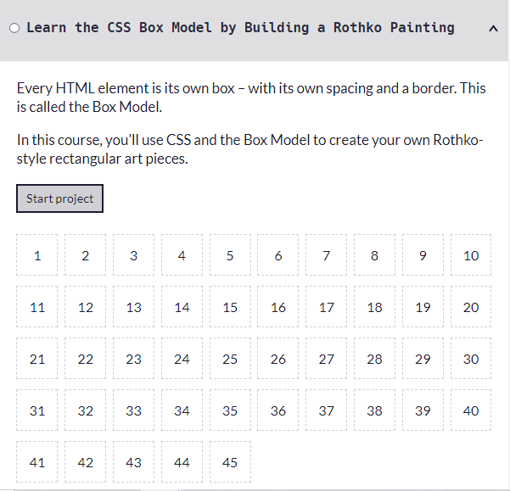
Week 6 assignment

Slide 24
Thank you

